Slide 1
ADVOCACY SKILLS
&
Come Learn
About Them All!
Come Learn About Them All!
Presented by:
Aimee Combs
Executive Director
Christy Moore
Family to Family Health Information Center Program Lead

Slide 2
Introductions
Who else is in the room?

Slide 3
About ECAC
ECAC is a private, nonprofit parent organization committed to improving the lives and education of ALL children, through a special emphasis on children with disabilities and special health care needs.
Empowering Families, Improving Lives

Slide 4
Project analysis slide 2
PTI & F2F
PTI
F2F
Parent Training & Information Center
Family to Family Health Information Center
Individual Assistance
Creation of Materials
Webinars & Workshops
Youth Engagement
Individual Assistance
Creation of Materials
Webinars & Workshops
Local, state and national system change / advisory groups
U.S. Department of Education
Office of Special Education Programs

Slide 5
Project analysis slide 2
Funded Partnerships
STAR
Program
NCDPI
Office of Exceptional Children
NCDPI
NC DeafBlind Project
NCDPI
NC State Improvement Project
LENS NC
Learning for Equity: A Network
for Solutions
Short Term Projects

Slide 6
Learning Objectives
Upon completion of this presentation, participants will be able to:
Define “advocacy”
Describe different types of advocacy
Identify ways to advocate effectively

Slide 7
Advocacy
advocacy
noun
ad·​vo·​ca·​cy ˈad-və-kə-sē
: the act or process of supporting a cause or proposal : the act or process of advocating
Merriam Webster
How do you define it?

Slide 8
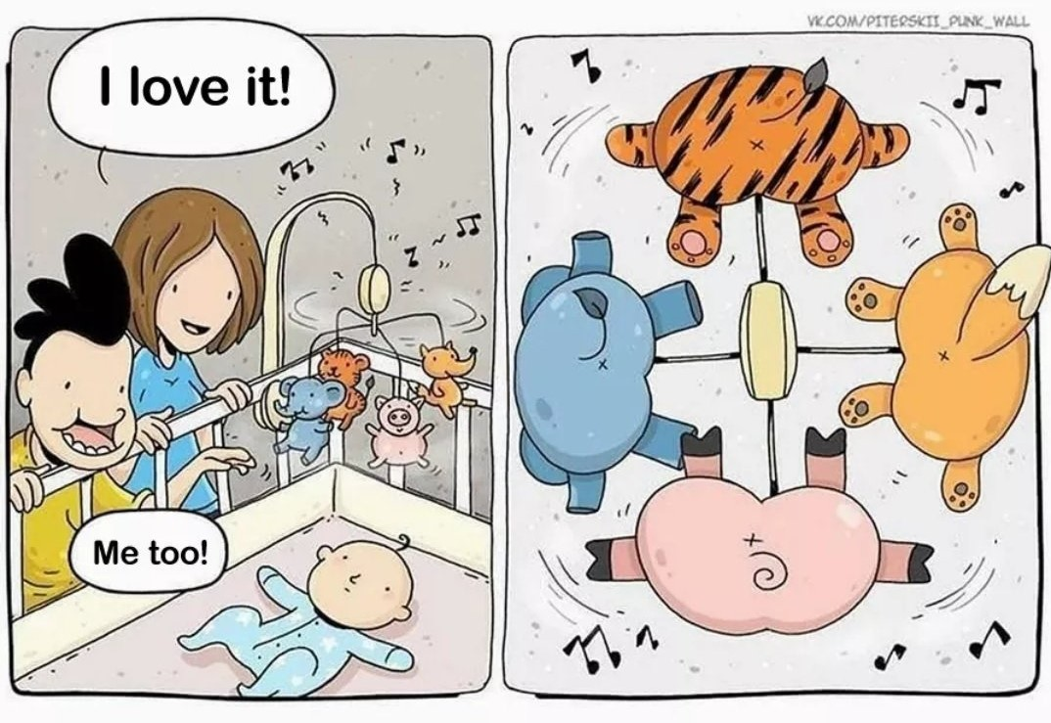
Why it Matters
What’s Wrong With This Picture?

Slide 9
3 Types of Advocacy
Self-Advocacy - A person’s ability to effectively speak up for themselves and push for their own interests, desires, needs and rights.
Individual Advocacy - A person or group speaks up for or on behalf of other people. This can be formal or informal.
Systems Advocacy - Efforts to change laws, policies or rules that affect people’s lives. This can happen at the local, state or national level.

Slide 10
Self-Advocacy
https://youtu.be/uaIyKo0Mu3Q

Slide 11
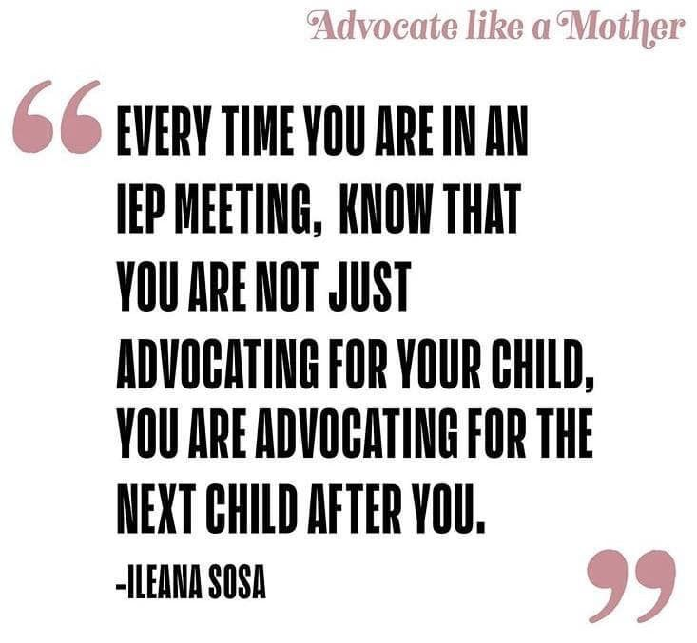
Individual Advocacy

Slide 12
Systems Advocacy
Systems advocacy involves efforts to change policies, rules, or laws. It aims to influence government, organization, or agency practices to better serve the collective voice, especially for vulnerable populations
Disability History: An Introduction - Disability & Philanthropy Forum (disabilityphilanthropy.org)
https://youtu.be/e9lkvA2LwkA
Notes:
Maybe show last 5 minutes of this video?
Disability History: An Introduction - Disability & Philanthropy Forum (disabilityphilanthropy.org)

Slide 13
Systems
Schools
Health Care
Government
Which ones have you navigated?
What worked? What didn’t?
Notes:
Public schools and healthcare are the two biggest systems that most of us will deal with. We can either be passive by-standers or active participants as we deal with these systems.
Having the right mindset makes the biggest difference. You can choose to view yourself as a person who has some power and should be respected.
We are not saying that you should run the world.
We ARE going to talk about some basic skills that can be helpful, regardless or which system you are working with.

Slide 14
Knowledge is Power!
Notes:
They say that knowledge is power. Do you believe that? Why?
No matter which system you are dealing with, people with more information have the best chance of having things go the way that they want.
It’s hard to be an effective advocate if you don’t know what’s going on.
The first advocacy skill we are going to mention is to increase your knowledge.
Knowing how to find the information that you need is an extremely important advocacy skill
To be effective, you need some information the system that you are dealing with. We will use the public school system as an example because almost everyone has had some experience with it.
There’s a lot to learn about how public schools work at the level of the school building, the school district, and even the state. We encourage everybody to learn who does what in your school. It may also be important to know who has the power to make which decisions. Then depending on what’s going on, you might need to look beyond the school building to get the information or result that you are looking for
Even when kids have disabilities, not everything that comes up is a special education issue. Some decisions can only be made by an IEP team. However, there are many other decisions, requirements and processes that IEP teams have no control over.
Don’t be afraid to ask questions!
Quiz: (For webinars, answers can be submitted in the chat. Do as a whole-group activity for an in-person workshop. Maybe have folks write down answers independently before calling on volunteers to share their responses. The presenter should make sure that the group gets the correct information.)
Who’s in charge of deciding if kids move to the next grade? (Principal)
Which grade level must give a reading test under state law? (3rd)
Where can you learn about your school’s bullying policy? (Parent-Student Handbook or School Board policy)

Slide 15
Become an Expert In Your Child’s Disability
Learn about the disability
How does the disability affect their communication, learning and participation?
Learn to describe your child’s strengths and needs.
Write down observations
Notes:
Learn about the disability
How does YOUR child’s disability look?
How does the disability affect their communication, learning and participation?
Learn to describe your child’s strengths and needs.
Write down observations
We talk with a lot of parents who truly are experts in their child’s disability, but they didn’t start out that way! If you need to learn more, you might start with your doctor or look online for reliable sources, typically ending in edu or org. ECAC can help you find more information too.
When you’re talking with people at school, it’s important to be able to describe how your child’s disability affects them at school—both their learning and their ability to participate, get along with other kids—think broadly! If you are talking with someone else about your child or young adult, you may want to tailor the information to include what is important to know in that setting. For example, there may be things important for folks to know in an overnight camp setting, that a tutor or job coach doesn’t need to know.

Slide 16
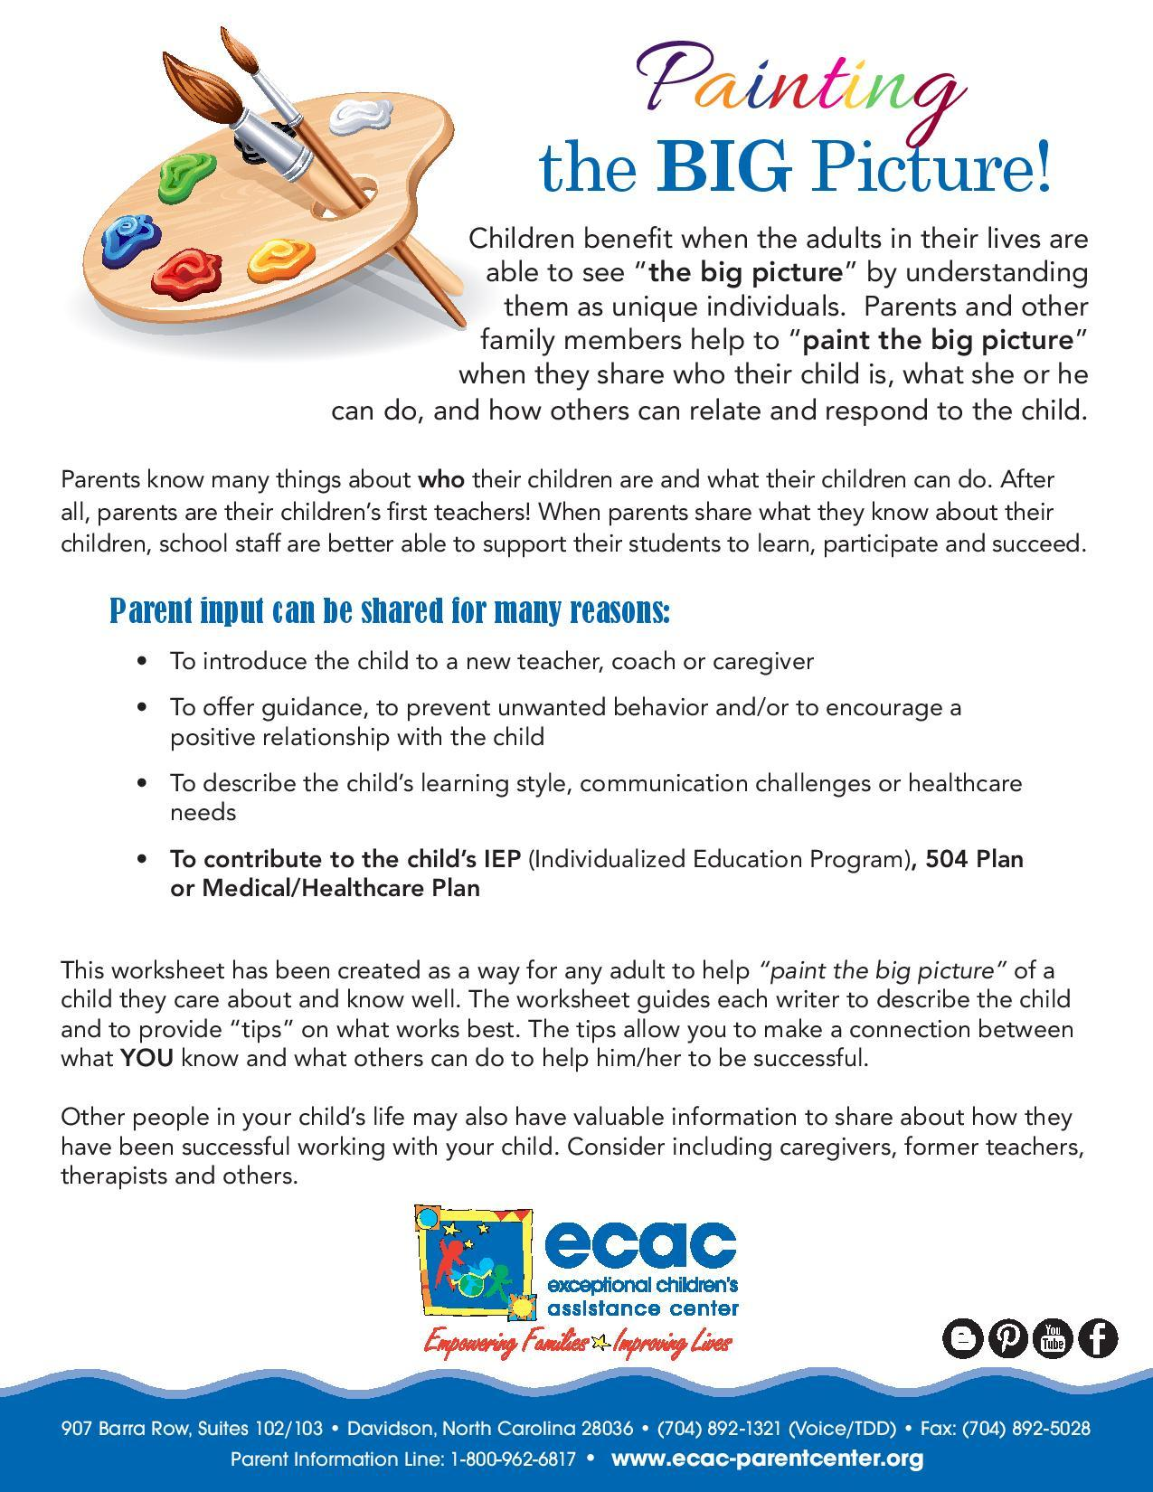
Share What You Know With Others
Notes:
Ongoing communication with ALL adults interacting with your child is important. This is one way we’ve developed for parents to share what they know. We believe this matters, and we’ve heard from many educators who agree.
You can use this the way it is here, or adapt it. Either way, it may help you describe you family and culture, think through your child’s strengths and challenges, and most importantly, share what you know about your child.

Slide 17
Build Positive Relationships
Culminates a more complete understanding of the individual, their abilities, strengths, challenges and needs
Establishes trust
Results in better outcomes
Makes tough conversations easier
Notes:
Communication and relationship building are the biggest keys to having successful team interactions., regardless of the setting Remember, we are all human, we are simply not going to like every single person that is a part of our child’s team, but we do need to all have a mutual respect for each other. We should also start with the belief that everyone who chooses to do this work has good intentions and wants your child to be healthy and successful.
You’ll be more effective if you build positive relationships with the professionals in your child’s life.
Try to remember—they are people too, and all relationships need attention! The last few years have been hard for a lot of people, and a kind word goes a long way. It’s going to work best if you and the people who work with your child are a team. You can think of this as prevention, or relationship capital.
Find out how your child’s teacher and the school leadership communicate with parents, and let them know if this doesn’t work for you, so you can set up another form of communication.
Make sure the teacher knows how to reach you and when you’re available
Building a relationship through effective and open communication can be the core of a successful educational experience for children. For teachers, being able to communicate with your students’ parents helps to better understand a child’s strengths and their own individual personality and learning style. The more information teachers have about a student, the more they can focus on teaching and being able to address and overcome challenges along the way that may be unique to each child. Effective communication between families and school staff culminates a more complete understanding of the student, their abilities, needs, strengths and challenges.
Families feel respected and are more likely to trust and work with schools to support their childs’ learning when information is shared with them openly and frequently. It is important that communication from school to home is in family friendly language. Regular home to school communication provides an avenue to inform families about children’s progress, skills, and strengths, and to share strategies on how to promote learning at home. Providing opportunities for families to share information can be game changer. When school staff listen, parents feel respected and known, and the school gets important information. All of this paves the way for establishing trust and successful school-home collaboration.
When families feel valued, they are more eager to share input and work together. These opportunities foster a sense of belonging for both the child and the parents. When parents and educators find a way to collaborate it strengthens the child’s identity and enhances their learning. Communicating and working together not only creates smooth transitions for students, but promotes family engagement and parent involvement.
The Individuals with Disabilities Education Act states “Almost 30 years of research and experience has demonstrated that the education of children with disabilities can be made more effective by—strengthening the role and responsibility of parents and ensuring that families of such children have meaningful opportunities to participate in the education of their children at school and at home” The IDEA recognizes that family engagement and parent involvement leads to improved outcomes for students with disabilities.
Collaboration and communication between home and school improves outcomes for all students. For students with disabilities, it is essential to have effective parent-teacher communication, collaboration and trust in order to establish and maintain respectful relationships. Students, Parents and School staff win when folks work together, remain student-centered and actively listen to understand one another.
Using the chat box, tell us what collaboration means to you. How would you define it?
Dictionary.com defines collaboration as: to work, one with another;
Think of collaboration as the act of working together, especially on a goal or shared project. It often implies not just cooperation but sharing and developing of each other’s ideas and perspectives.
Education is increasingly viewed as a shared responsibility of educators and families. This became even more apparent during the pandemic. Investing some time and effort into building partnerships with your parents can provide numerous benefits- for everyone. Active and effective communication and collaboration between parents and schools can be a true asset to a school district by:
providing opportunities for parent involvement and input into special education issues
Making difficult conversations easier- such as discipline issues, possibly reducing the use of formal dispute resolution options
helping improve educational outcomes and well-being for all students, including those with disabilities;
Creating a mutual trust to support a child’s learning ultimately helps improve educational outcomes and well-being for all students, including those with disabilities/

Slide 18
Prepare for Meetings and Appointments
Make sure you understand the purpose
Ask about what to expect
Bring or submit requested documentation
Write down your questions and concerns
Write down anything that you plan to propose
Be prepared to offer explanations or examples (This is useful data)
If your solution to a problem is rejected, ask for another option
Arrive on time to reduce unnecessary stress
Notes:
Use your advocacy skills strategically. You want to make sure that your facts are straight because people may use an error to discredit you and ignore the real issue.
Try to anticipate objections and plan to overcome them. Consider asking a trusted person to play “Devil’s Advocate” to get a different perspective.
Give people a chance to do the right thing before going over their heads.

Slide 19
Advocacy Skills & Strategies
Effective advocacy may involve multiple steps - Be strategic!
Check the facts before taking action
Lay the groundwork for a “win” later
Find out who has the authority to do what you want
Follow the chain of command
Play by the rules so that there is no excuse to shut you down
Notes:
Use your advocacy skills strategically. You want to make sure that your facts are straight because people may use an error to discredit you and ignore the real issue.
Try to anticipate objections and plan to overcome them. Consider asking a trusted person to play “Devil’s Advocate” to get a different perspective.
Give people a chance to do the right thing before going over their heads.

Slide 20
“Show Me Where It Says That”
The power of the written word can help distinguish fact from fiction
Determine what a reported policy or law actually says
Clarifying misunderstandings should lead to change in behavior
Notes:
Use your advocacy skills strategically. You want to make sure that your facts are straight because people may use an error to discredit you and ignore the real issue.
Try to anticipate objections and plan to overcome them. Consider asking a trusted person to play “Devil’s Advocate” to get a different perspective.
Give people a chance to do the right thing before going over their heads.

Slide 21
Questions Can Be Powerful Tools
What does the data show?
What are our options?
What will the recommended intervention or treatment look like as it is implemented?
What are the pros and cons?
How will we know if it’s working?
What are the next steps?
What other ideas do you have to meet my child’s needs?
Notes:
Use your advocacy skills strategically. You want to make sure that your facts are straight because people may use an error to discredit you and ignore the real issue.
Try to anticipate objections and plan to overcome them. Consider asking a trusted person to play “Devil’s Advocate” to get a different perspective.
Give people a chance to do the right thing before going over their heads.

Slide 22
Tips to Avoid the “NO!”
Do not ask questions that allow folks to say “NO” without adequate consideration of your point or request.
Instead of asking, “Can we do an assistive technology evaluation?” Make a statement :
“I want to have an evaluation done to see if there is any assistive technology that could help (my child) communicate more effectively.”
“I need to have an accommodation so that I can do my job well.”
Basically, don’t ask yes/no questions if “no” is not an acceptable response
Notes:
Use your advocacy skills strategically. You want to make sure that your facts are straight because people may use an error to discredit you and ignore the real issue.
Try to anticipate objections and plan to overcome them. Consider asking a trusted person to play “Devil’s Advocate” to get a different perspective.
Give people a chance to do the right thing before going over their heads.

Slide 23
Get the Data and Give the Data
Types of Data
Quantitative Data
Typically numbers
Answers the questions:
How much? How often?
Qualitative Data
Typically descriptions
Answers the questions:
What is it like? What was observed?
Data helps you to be prepared to back up requests
Plan on what you want to collect and why
Have a method for collecting, organizing and sharing data
Notes:
Example: Autism screening gone wrong
School wanted to change AOE from AU to OHI
Do you have an example of data collection that helped you be successful in advocating?

Slide 24
Important Advocacy Tips to Remember
Decide on and prioritize issues you are trying to address
Collect data (It matters!)
Asking for clarification on something you don’t understand
Know how to find relevant policies and procedures
Learn about dispute resolution or appeals processes
Utilize trustworthy resources to research topics
Remain calm and focused on the desired outcome
Focus on facts, not feelings
Plan what to do if someone tells you “no” or “I can’t help you” (What are other options? Who else can I talk to? Where can I find more information?)
Notes:
This is mostly a recap of tips offered earlier, so we can be very brief.
Know the issues - instead of saying something like “my child needs more speech therapy”, think about the actual issue you are trying to address. Is is social skill deficits? Anxiety? expressive language? Functional skills? (Broken molar example)
Collecting Data - Professionals go to school for many years and learn a whole lot about their field of study. They do internships or residencies and learn even more. But we as parents have valuable knowledge that is specific to our children. This can’t be learned at any university. This specific knowledge needs to come together with the general knowledge of professionals in order to achieve the best outcomes for our kids.
Ask for clarification - how many of you have been in a meeting or at an appointment and the professionals in the room use acronyms or language that you did not understand. (Show of hands) asking for clarification is advocating for for, but also for others. Odds are that if you are participating in a meeting, advisory group, training, etc. and someone uses an acronym or term that you are unfamiliar with, others may be unfamiliar with it too, and will also benefit from your advocacy. Even those who are not currently present my benefit from your advocacy because It also shows the sharer of that information that they will need to define and explain the acronyms and terms they use to make their information more understandable and accessible.
Policies and procedures - education, healthcare, programs, Medicaid - all of these things will have written policies and procedures. One example I like to talk about is the unfortunate case of bullying. Bullying happens all too often and parents often feel powerless. Did you know that schools are required to have a bullying policy? If you feel that bullying is not being adequately handled, ask to see the schools’ bullying policy so you can determine if it is being followed. Medicaid clinical coverage policies are another thing to be aware of - get the facts, open for public comment, request for coverage form
Topical research - important components of transition planning (postsecondary education options, employments services, healthcare transition), Executive functioning skills, (my example of how autism presents in girls)
Remaining calm and focused - it is so easy to get upset and heated, we are talking about our kids/loved ones after all - if you are hitting roadblocks, one approach is to present the problem and ask for the person’s help in coming up with solutions - instead of demanding that things be fixed.
What can you do if someone tells you no or they can’t help you? I always reccomend that you don’t ever leave this conversation without asking
What tips didn’t we mention?

Slide 25
Expand Your Advocacy Reach
People with lived experience should be at the table when important decisions are being made.
Opportunities to do this range from the PTA, speaking at public meetings to serving on advisory boards and statewide councils.
Stay connected to stay informed!
Meetings of government are open to the public
Follow disability organizations and trusted groups on Facebook
Subscribe to get notices and newsletters
Local news outlets
Notes:
Your resource list includes some of the opportunities available in NC to take actions that could lead to changes that help many other people.
Subscribe to get newsletters and notices from disability advocacy organizations and government agencies.
Follow trusted Facebook groups.
Local news outlets will often share local events on their programs, streaming apps and websites. They will often have information about important matters being discussed during government meetings.
Most government meetings are open to the public except for when confidential and personnel matters are being discussed. These days, most of those meetings can also be viewed online.
Look out for notices of public hearings about proposed policy changes. Those chances to offer input are often only open for a short time.

Slide 26
Seek Advocacy & Leadership Opportunities
Telling Your Story Webinars and Workshops
Parents As Collaborative Leaders
Family Leadership Conferences
Me 101 Self-Advocacy
Student Led IEPs
ECAC’s Junior Youth Advisory Team (JYAT) & Youth Advisory Team (YAT)
Notes:
Your resource list includes some of the opportunities available in NC to take actions that could lead to changes that help many other people.
Subscribe to get newsletters and notices from disability advocacy organizations and government agencies.
Follow trusted Facebook groups.
Local news outlets will often share local events on their programs, streaming apps and websites. They will often have information about important matters being discussed during government meetings.
Most government meetings are open to the public except for when confidential and personnel matters are being discussed. These days, most of those meetings can also be viewed online.
Look out for notices of public hearings about proposed policy changes. Those chances to offer input are often only open for a short time.

Slide 27
Seek Advocacy & Leadership Opportunities
The NCDSA is joining with national organizations such as The Arc, the National Down Syndrome Society, and the National Down Syndrome Congress in telling our Members of Congress that individuals with disabilities deserve to be able to work, save, and earn their way to independence! To date, no North Carolina US Senators or House Members have co-sponsored the bi-partisan SSI Savings Penalty Elimination Act (S 2767/HR 5408).
Notes:
Your resource list includes some of the opportunities available in NC to take actions that could lead to changes that help many other people.
Subscribe to get newsletters and notices from disability advocacy organizations and government agencies.
Follow trusted Facebook groups.
Local news outlets will often share local events on their programs, streaming apps and websites. They will often have information about important matters being discussed during government meetings.
Most government meetings are open to the public except for when confidential and personnel matters are being discussed. These days, most of those meetings can also be viewed online.
Look out for notices of public hearings about proposed policy changes. Those chances to offer input are often only open for a short time.

Slide 28
Seek Advocacy & Leadership Opportunities
My Story Matters is a new campaign, launched on March 1, 2024 during Developmental Disabilities (DD) Awareness Month, by the North Carolina Council on Developmental Disabilities (NCCDD) to learn about North Carolinians with intellectual and other developmental disabilities (I/DD) across the state and the issues that are important to them.
Your story is important! Your story is also a form of advocacy. Sharing your story with us can help us advocate together with key decision makers, lawmakers, and people who can help us make life better for people with I/DD like you in North Carolina.

Slide 29
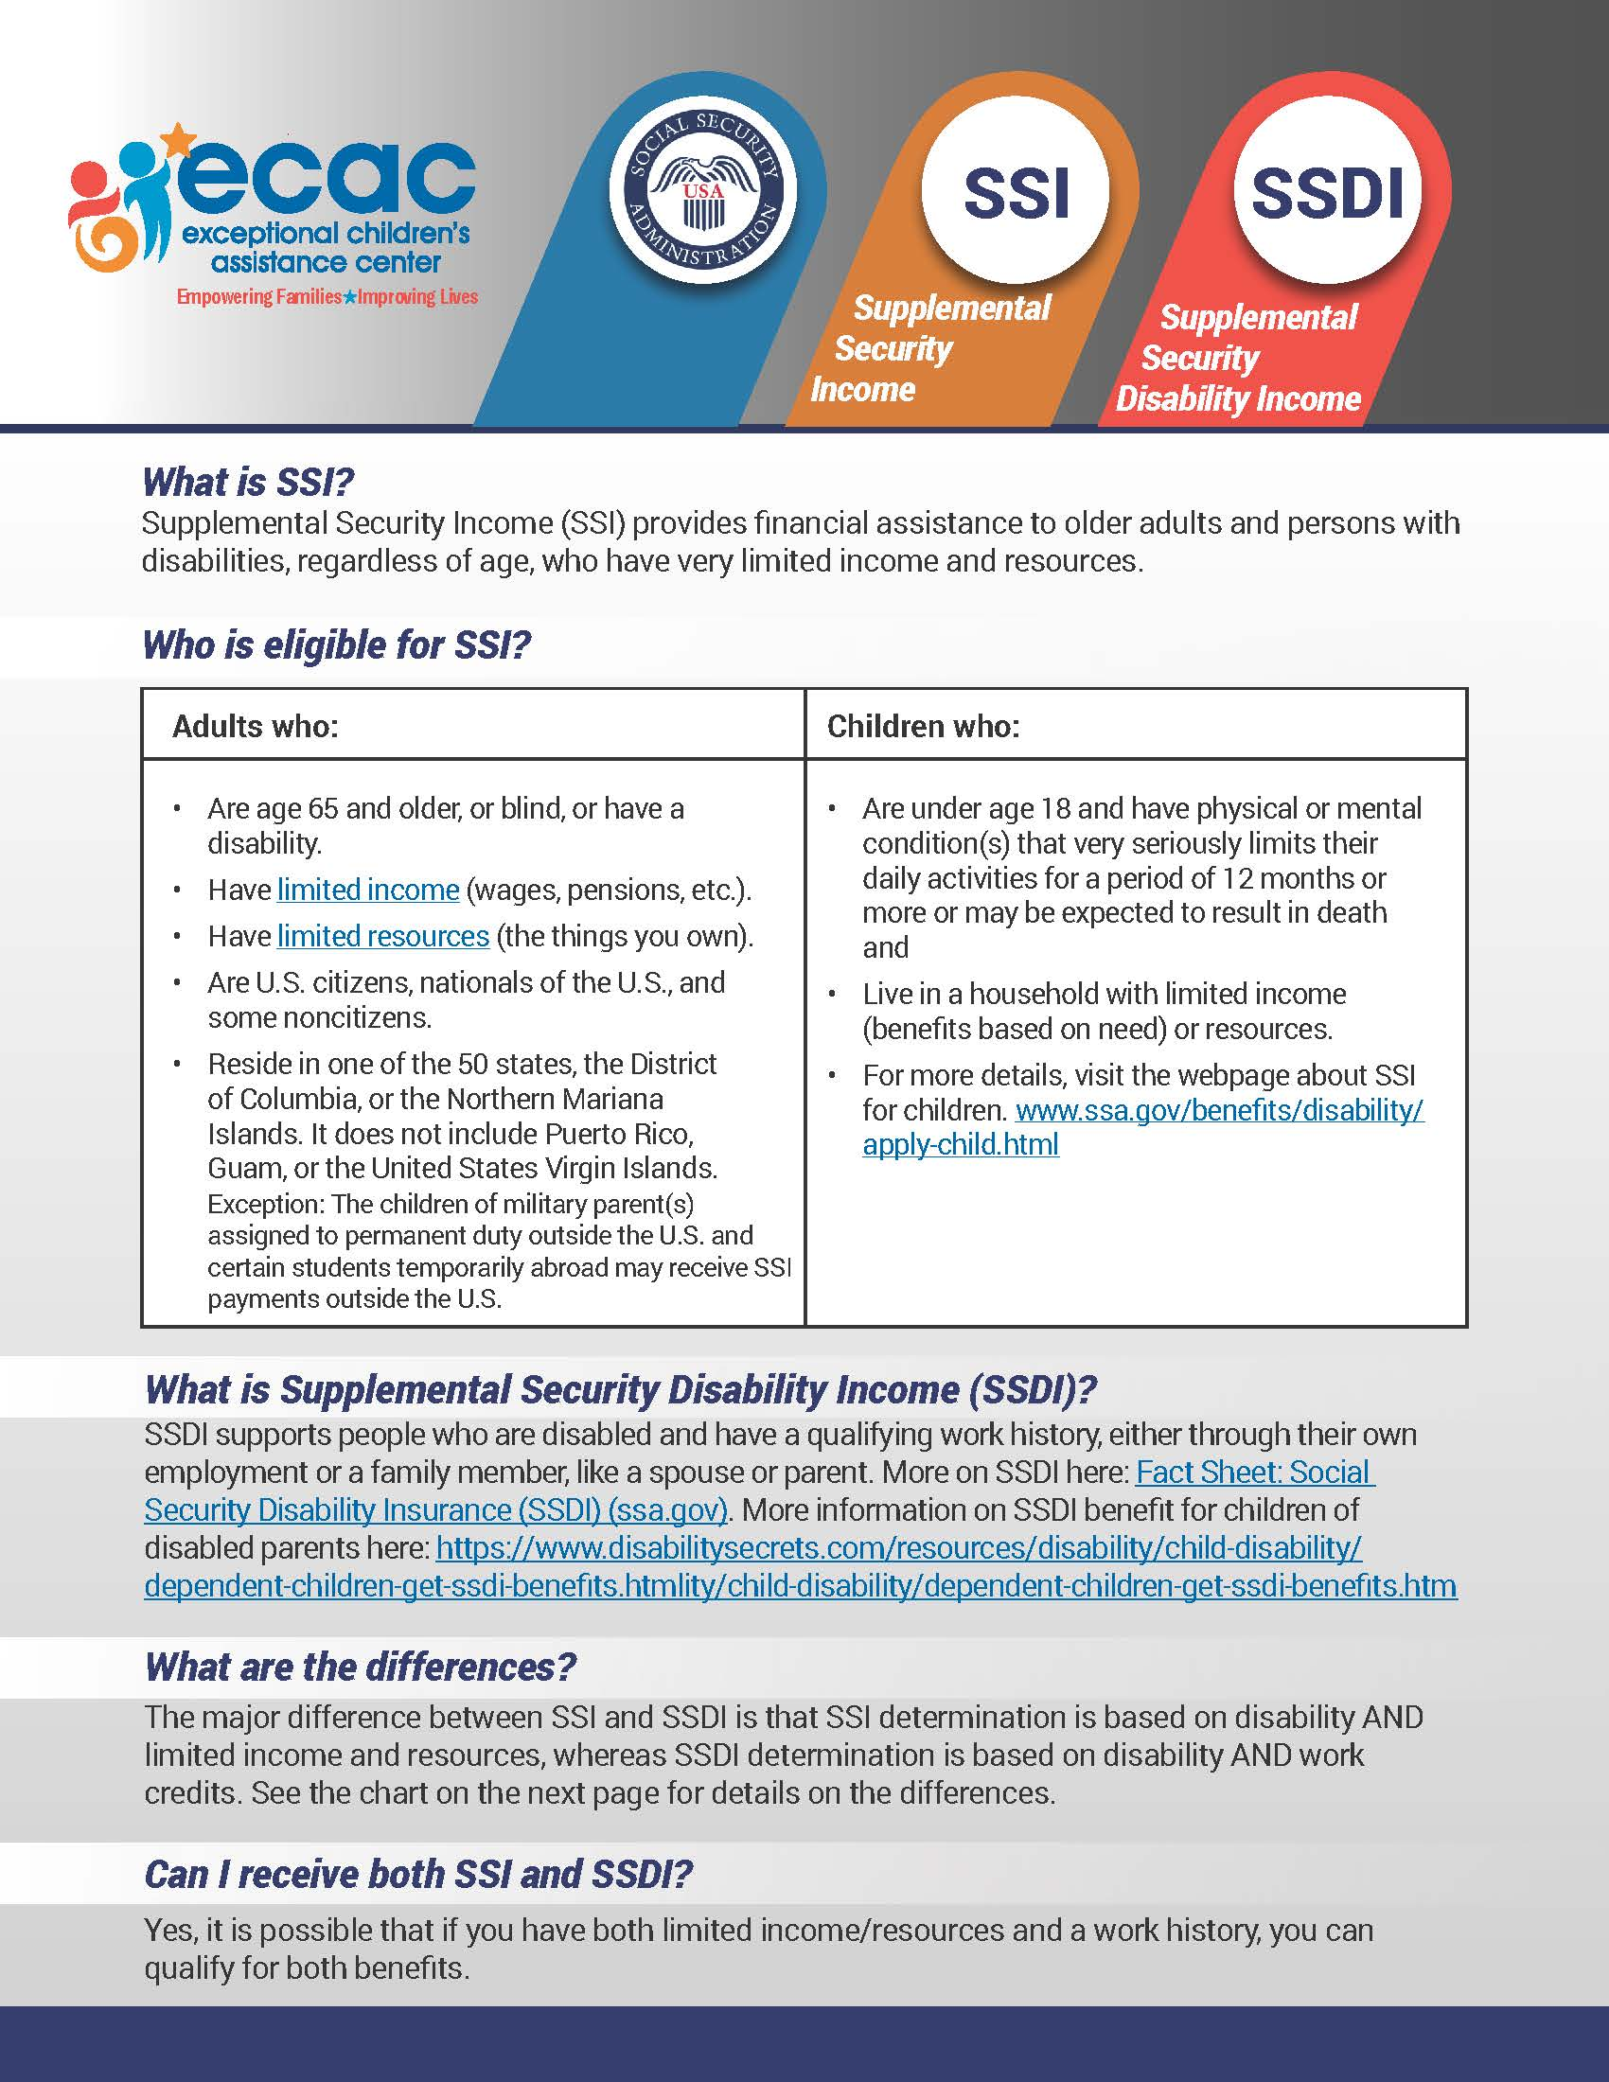
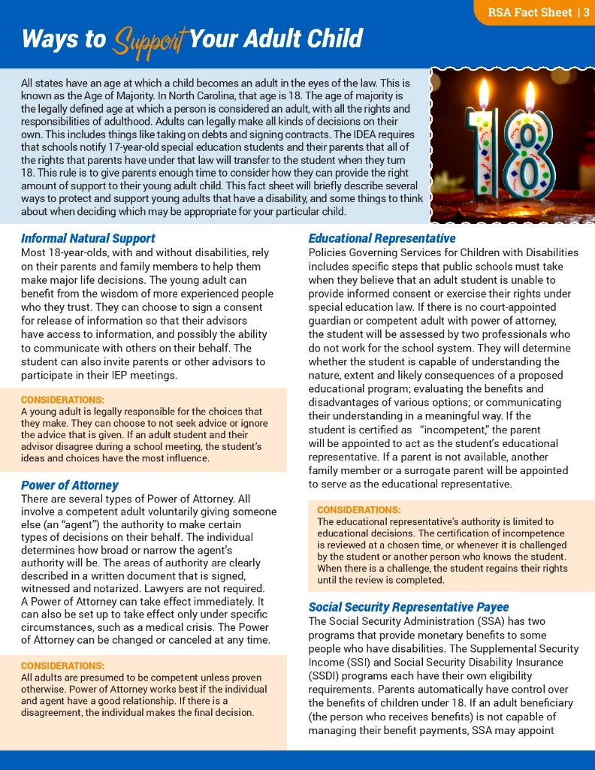
Tools & Resources
Accommodations to Consider for Students with Problems in Organization
Adaptations and Modifications
Supplemental Security Income / Supplemental Security Disability Income
Medicaid Waivers in NC
IEP Checklist
Student Snapshot
Painting the Big Picture English and Spanish
Family to Family Health Information Center flyer English and Spanish

Slide 30
Webinar Recordings on ECAC Website & YouTube Channel
Registry of Unmet Needs: AKA The Innovations Waiver Waiting List
NC Able Accounts
The Exceptional Experience Podcast Series
Introduction to Assistive Technology
Transitioning to Adult Healthcare: How Students and Families Can Prepare
A Guide to Guardianship
NEW! Self-Advocacy is for Everyone

Slide 31
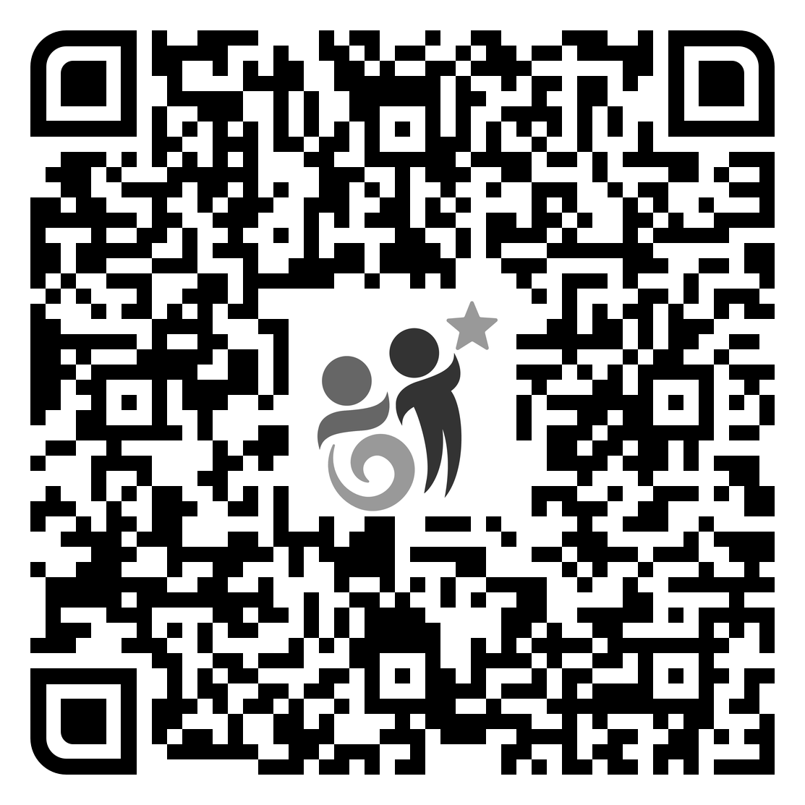
Survey Says?
ECAC is funded largely by grants. We collect data on our activities for grant reporting purposes and to make improvements to meet the needs of families and professionals across NC. We appreciate your feedback!

Slide 32
Questions?

Slide 33
“I am only one, but still I am one. I cannot do everything, but still I can do something; and because I cannot do everything, I will not refuse to do something that I can do.”
—HELEN KELLER

Slide 34
THANK YOU!
1-800-962-6817
www.ecac-parentcenter.org

